Slide 1

Data-Intensive Distributed Computing
CS 431/631 451/651 (Winter 2019)
Part 2: From MapReduce to Spark (1/2)
January 22, 2019
Adam Roegiest
Kira Systems
These slides are available at http://roegiest.com/bigdata-2019w/
This work is licensed under a Creative Commons Attribution-Noncommercial-Share Alike 3.0 United States
See http://creativecommons.org/licenses/by-nc-sa/3.0/us/ for details

Slide 2

Source: Wikipedia (The Scream)

Slide 3
Debugging at Scale
Works on small datasets, won’t scale… why?
Memory management issues (buffering and object creation)
Too much intermediate data
Mangled input records
Real-world data is messy!
There’s no such thing as “consistent data”
Watch out for corner cases
Isolate unexpected behavior, bring local

Slide 4
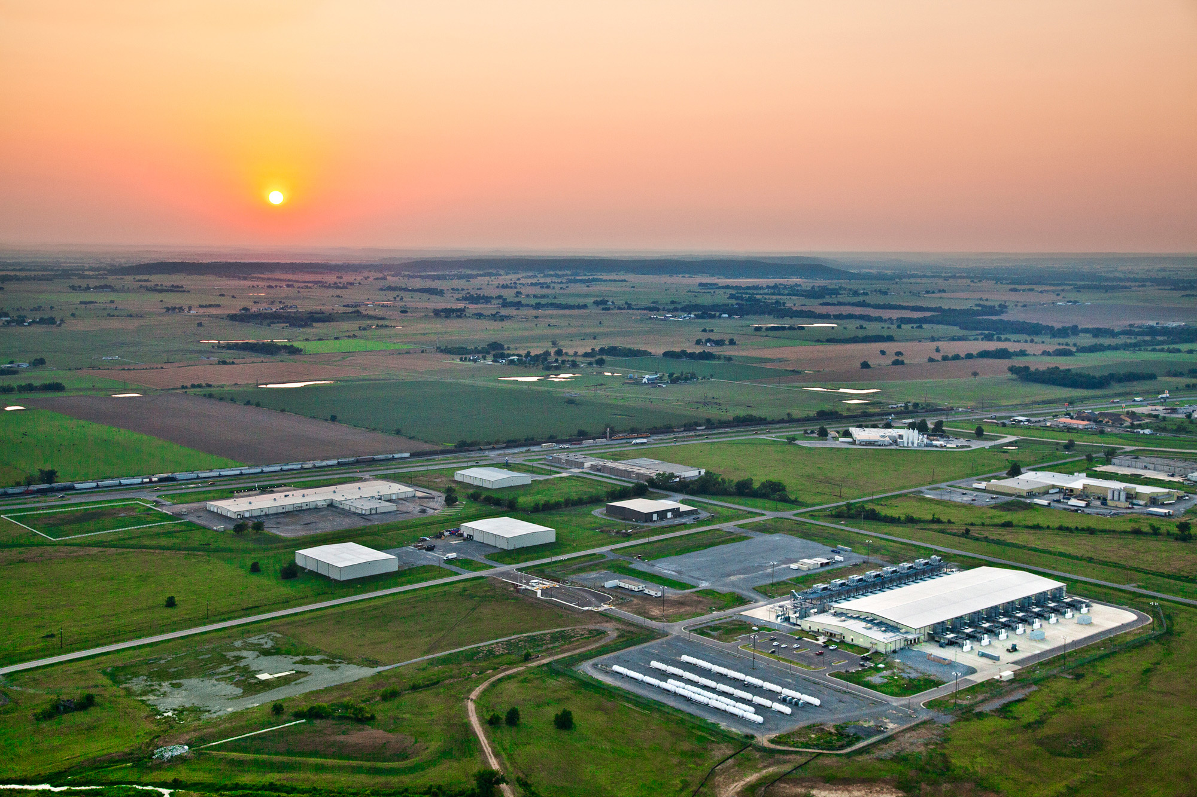
The datacenter is the computer!
What’s the instruction set?
Source: Google

Slide 5

So you like programming in assembly?
Source: Wikipedia (ENIAC)

Slide 6

Hadoop is great, but it’s really waaaaay too low level!
(circa 2007)
Source: Wikipedia (DeLorean time machine)

Slide 7
What’s the solution?
Design a higher-level language
Write a compiler

Slide 8




Hadoop is great, but it’s really waaaaay too low level!
(circa 2007)
What we really need is a scripting language!
What we really need is SQL!
Answer:
Answer:

Slide 9
SQL
Pig Scripts
Aside: Why not just
use a database?
map
map
map
map
map
map
…
map
map
…
map
…
map
map
…
map
map
map
…
map
map
map
…
map
reduce
reduce
reduce
map
map
…
map
reduce
reduce
reduce
map
map
…
map
…
reduce
reduce
…
reduce
…
reduce
reduce
…
reduce
reduce
reduce
…
reduce
reduce
reduce
…
reduce
reduce
reduce
…
reduce
reduce
reduce
…
reduce
Both open-source projects today!

Slide 10

Story for another day….
Jeff Hammerbacher, Information Platforms and the Rise of the Data Scientist.
In, Beautiful Data, O’Reilly, 2009.
“On the first day of logging the Facebook clickstream, more than 400 gigabytes of data was collected. The load, index, and aggregation processes for this data set really taxed the Oracle data warehouse. Even after significant tuning, we were unable to aggregate a day of clickstream data in less than 24 hours.”

Slide 11
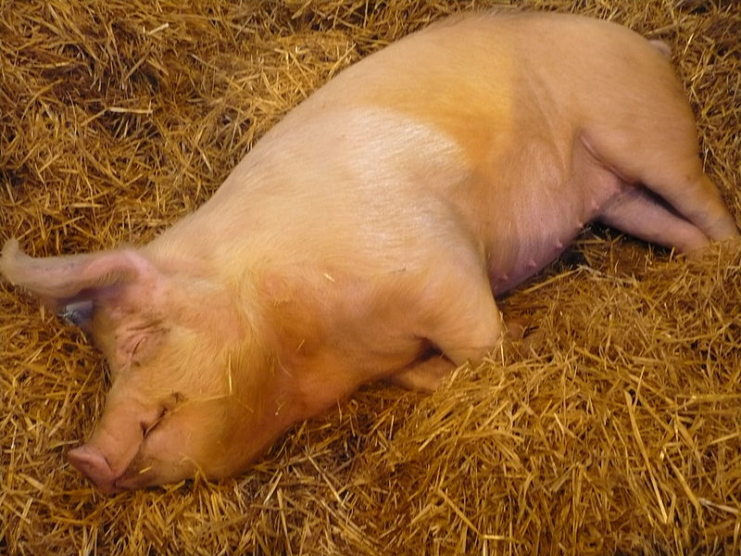
Pig!
Source: Wikipedia (Pig)

Slide 12
Pig: Example
Task: Find the top 10 most visited pages in each category
Visits
URL Info
User | Url | Time
Amy | cnn.com | 8:00
Amy | bbc.com | 10:00
Amy | flickr.com | 10:05
Fred | cnn.com | 12:00
Url | Category | PageRank
cnn.com | News | 0.9
bbc.com | News | 0.8
flickr.com | Photos | 0.7
espn.com | Sports | 0.9
Pig Slides adapted from Olston et al. (SIGMOD 2008)

Slide 13
Pig: Example Script
visits = load ‘/data/visits’ as (user, url, time);
gVisits = group visits by url;
visitCounts = foreach gVisits generate url, count(visits);
urlInfo = load ‘/data/urlInfo’ as (url, category, pRank);
visitCounts = join visitCounts by url, urlInfo by url;
gCategories = group visitCounts by category;
topUrls = foreach gCategories generate top(visitCounts,10);
store topUrls into ‘/data/topUrls’;
Pig Slides adapted from Olston et al. (SIGMOD 2008)

Slide 14
Pig Query Plan
load visits
group by url
foreach url
generate count
load urlInfo
join on url
group by category
foreach category
generate top(urls, 10)
Pig Slides adapted from Olston et al. (SIGMOD 2008)

Slide 15
Pig: MapReduce Execution
load visits
Map₁
group by url
Reduce₁
Map₂
foreach url
generate count
load urlInfo
join on url
Reduce₂
group by category
Map₃
Reduce₃
foreach category
generate top(urls, 10)
Pig Slides adapted from Olston et al. (SIGMOD 2008)

Slide 16
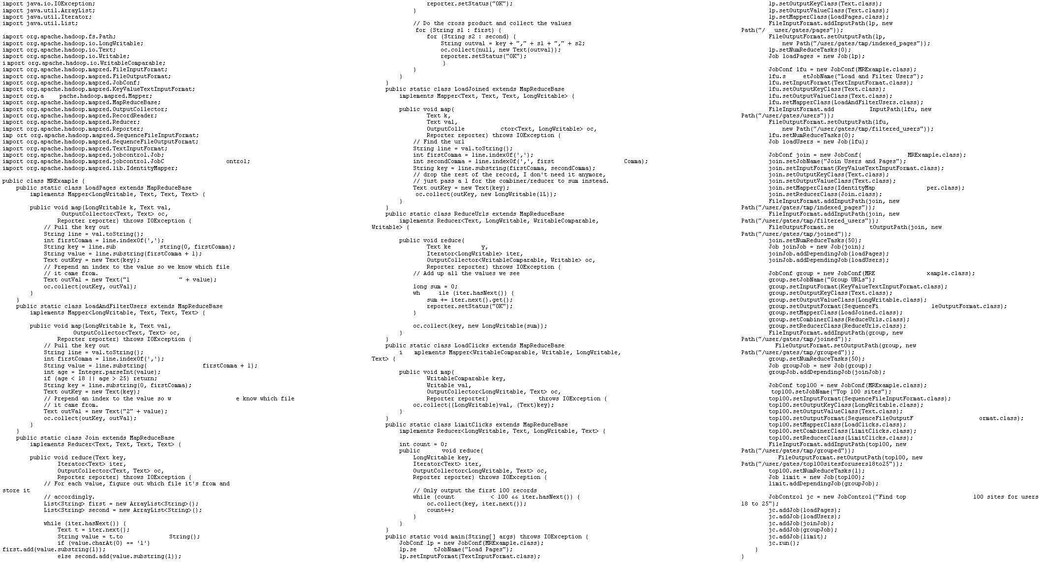
visits = load ‘/data/visits’ as (user, url, time);
gVisits = group visits by url;
visitCounts = foreach gVisits generate url, count(visits);
urlInfo = load ‘/data/urlInfo’ as (url, category, pRank);
visitCounts = join visitCounts by url, urlInfo by url;
gCategories = group visitCounts by category;
topUrls = foreach gCategories generate top(visitCounts,10);
store topUrls into ‘/data/topUrls’;
This?
Or this?

Slide 17
But isn’t Pig slower?
Sure, but c can be slower than assembly too…

Slide 18
Pig: Basics
Sequence of statements manipulating relations (aliases)
Data model
atoms
tuples
bags
maps
json

Slide 19
Pig: Common Operations
LOAD: load data (from HDFS)
FOREACH … GENERATE: per tuple processing
“map”
FILTER: discard unwanted tuples
GROUP/COGROUP: group tuples
“reduce”
JOIN: relational join
STORE: store data (to HDFS)

Slide 20
Pig: GROUPing
A = LOAD 'myfile.txt’ AS (f1: int, f2: int, f3: int);
(1, 2, 3)
(4, 2, 1)
(8, 3, 4)
(4, 3, 3)
(7, 2, 5)
(8, 4, 3)
X = GROUP A BY f1;
(1, {(1, 2, 3)})
(4, {(4, 2, 1), (4, 3, 3)})
(7, {(7, 2, 5)})
(8, {(8, 3, 4), (8, 4, 3)})

Slide 21
Pig: COGROUPing
A:
(1, 2, 3)
(4, 2, 1)
(8, 3, 4)
(4, 3, 3)
(7, 2, 5)
(8, 4, 3)
B:
(2, 4)
(8, 9)
(1, 3)
(2, 7)
(2, 9)
(4, 6)
(4, 9)
X = COGROUP A BY $0, B BY $0;
(1, {(1, 2, 3)}, {(1, 3)})
(2, {}, {(2, 4), (2, 7), (2, 9)})
(4, {(4, 2, 1), (4, 3, 3)}, {(4, 6),(4, 9)})
(7, {(7, 2, 5)}, {})
(8, {(8, 3, 4), (8, 4, 3)}, {(8, 9)})

Slide 22
Pig: JOINing
A:
(1, 2, 3)
(4, 2, 1)
(8, 3, 4)
(4, 3, 3)
(7, 2, 5)
(8, 4, 3)
B:
(2, 4)
(8, 9)
(1, 3)
(2, 7)
(2, 9)
(4, 6)
(4, 9)
X = JOIN A BY $0, B BY $0;
(1,2,3,1,3)
(4,2,1,4,6)
(4,3,3,4,6)
(4,2,1,4,9)
(4,3,3,4,9)
(8,3,4,8,9)
(8,4,3,8,9)

Slide 23
Pig UDFs
User-defined functions:
Java
Python
JavaScript
Ruby
…
UDFs make Pig arbitrarily extensible
Express “core” computations in UDFs
Take advantage of Pig as glue code for scale-out plumbing

Slide 24
The datacenter is the computer!
What’s the instruction set?
Okay, let’s fix this!
Source: Google

Slide 25
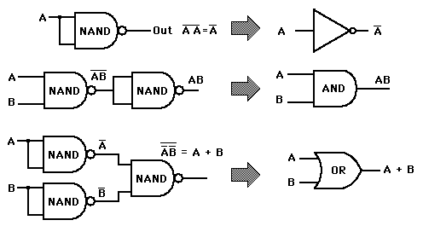
Analogy: NAND Gates are universal

Slide 26
Let’s design a data processing
language “from scratch”!
What ops do you need?
(Why is MapReduce the way it is?)

Slide 27
Data-Parallel Dataflow Languages
We have a collection of records,
want to apply a bunch of operations
to compute some result
Assumption: static collection of records
(what’s the limitation here?)

Slide 28
We need per-record processing
r₁
r₂
r₃
r₄
…
r_{n-1}
r_{n}
map
map
map
…
r’₁
r'₂
r’₃
r’₄
…
r'_{n-1}
r_{n}
Remarks: Easy to parallelize maps,
record to “mapper” assignment is an implementation detail

Slide 29
Map alone isn’t enough
(If we want more than embarrassingly parallel processing)
Where do intermediate results go?
We need an addressing mechanism!
What’s the semantics of the group by?
Once we resolve the addressing, apply another computation
That’s what we call reduce!
(What’s with the sorting then?)

Slide 30
MapReduce
r₁
r₂
r₃
r₄
…
r_{n-1}
r_{n}
map
map
map
…
reduce
reduce
…
reduce
r’₁
r'₂
r’₃
r’₄
…
r'_{n-1}
r_{n}
MapReduce is the minimally “interesting” dataflow!

Slide 31
MapReduce
List[(K1,V1)]
map
f: (K1, V1)
⇒ List[(K2, V2)]
reduce
g: (K2, Iterable[V2]) ⇒ List[(K3, V3)]
List[K3,V3])
(note we’re abstracting the “data-parallel” part)

Slide 32
MapReduce Workflows
HDFS
map
map
map
map
reduce
reduce
reduce
reduce
HDFS
HDFS
HDFS
HDFS
What’s wrong?

Slide 33
Want MM?
HDFS
HDFS
map
map
map
map
HDFS
HDFS
HDFS
✔
✗

Slide 34
Want MRR?
HDFS
HDFS
map
map
map
reduce
reduce
reduce
reduce
HDFS
HDFS
HDFS
✔
✗

Slide 35
The datacenter is the computer!
Let’s enrich the instruction set!
Source: Google

Slide 36
Dryad: Graph Operators
Source: Isard et al. (2007) Dryad: Distributed Data-Parallel Programs from Sequential Building Blocks. EuroSys.

Slide 37
Dryad: Architecture
The Dryad system organization. The job manager (JM) consults the name server (NS) to discover the list of available computers. It maintains the job graph and schedules running vertices (V) as computers become available using the daemon (D) as a proxy. Vertices exchange data through files, TCP pipes, or shared-memory channels. The shaded bar indicates the vertices in the job that are currently running.
Source: Isard et al. (2007) Dryad: Distributed Data-Parallel Programs from Sequential Building Blocks. EuroSys.

Slide 38
Dryad: Cool Tricks
Channel: abstraction for vertex-to-vertex communication
File
TCP pipe
Shared memory
Runtime graph refinement
Size of input is not known until runtime
Automatically rewrite graph based on invariant properties
Source: Isard et al. (2007) Dryad: Distributed Data-Parallel Programs from Sequential Building Blocks. EuroSys.

Slide 39
Dryad: Sample Program
Source: Isard et al. (2007) Dryad: Distributed Data-Parallel Programs from Sequential Building Blocks. EuroSys.

Slide 40
DryadLINQ
LINQ = Language INtegrated Query
.NET constructs for combining imperative and declarative programming
Developers write in DryadLINQ
Program compiled into computations that run on Dryad
Sound familiar?
Source: Yu et al. (2008) DryadLINQ: A System for General-Purpose Distributed Data-Parallel Computing Using a High-Level Language. OSDI.

Slide 41
What’s the solution?
Design a higher-level language
Write a compiler

Slide 42
DryadLINQ: Word Count
PartitionedTable<LineRecord> inputTable =
PartitionedTable.Get<LineRecord>(uri);
IQueryable<string> words = inputTable.SelectMany(x => x.line.Split(' '));
IQueryable<IGrouping<string, string>> groups = words.GroupBy(x => x);
IQueryable<Pair> counts = groups.Select(x => new Pair(x.Key, x.Count()));
IQueryable<Pair> ordered = counts.OrderByDescending(x => x.Count);
IQueryable<Pair> top = ordered.Take(k);
Compare:
a = load ’file.txt' as (text: chararray);
b = foreach a generate flatten(TOKENIZE(text)) as term;
c = group b by term;
d = foreach c generate group as term, COUNT(b) as count;
store d into 'cnt';
Compare and contrast…

Slide 43
What happened to Dryad?
The Dryad system organization. The job manager (JM) consults the name server (NS) to discover the list of available computers. It maintains the job graph and schedules running vertices (V) as computers become available using the daemon (D) as a proxy. Vertices exchange data through files, TCP pipes, or shared-memory channels. The shaded bar indicates the vertices in the job that are currently running.
Source: Isard et al. (2007) Dryad: Distributed Data-Parallel Programs from Sequential Building Blocks. EuroSys.

Slide 44
Data-Parallel Dataflow Languages
We have a collection of records,
want to apply a bunch of operations
to compute some result
What are the dataflow operators?

Slide 45
Spark
Answer to “What’s beyond MapReduce?”
Brief history:
Developed at UC Berkeley AMPLab in 2009
Open-sourced in 2010
Became top-level Apache project in February 2014
Commercial support provided by DataBricks

Slide 46
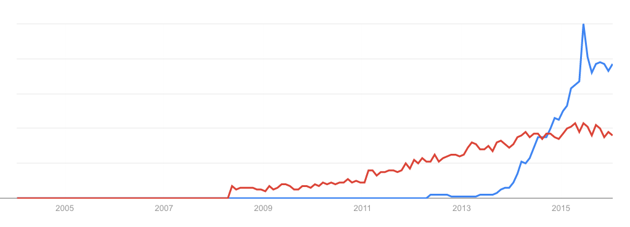
Spark vs. Hadoop
November 2014
Google Trends
Source: Datanami (2014): http://www.datanami.com/2014/11/21/spark-just-passed-hadoop-popularity-web-heres/

Slide 47
What’s an RDD?
Resilient Distributed Dataset (RDD)
Much more next session…

Slide 48
MapReduce
List[(K1,V1)]
map
f: (K1, V1)
⇒ List[(K2, V2)]
reduce
g: (K2, Iterable[V2]) ⇒ List[(K3, V3)]
List[K3,V3])

Slide 49
Map-like Operations
RDD[T]
RDD[T]
RDD[T]
RDD[T]
map
f: (T)
⇒ U
filter
f: (T) ⇒ Boolean
flatMap
f: (T) ⇒ TraversableOnce[U]
mapPartitions
f: (Iterator[T])
⇒ Iterator[U]
RDD[U]
RDD[T]
RDD[U]
RDD[U]
(Not meant to be exhaustive)

Slide 50
Reduce-like Operations
RDD[(K, V)]
RDD[(K, V)]
RDD[(K, V)]
groupByKey
reduceByKey
f: (V, V) ⇒ V
aggregateByKey
seqOp: (U, V) ⇒ U, combOp: (U, U) ⇒ U
RDD[(K, Iterable[V])]
RDD[(K, V)]
RDD[(K, U)]
(Not meant to be exhaustive)

Slide 51
Sort Operations
RDD[(K, V)]
RDD[(K, V)]
sort
repartitionAnd
SortWithinPartitions
RDD[(K, V)]
RDD[(K, V)]
(Not meant to be exhaustive)

Slide 52
Join-like Operations
RDD[(K, V)]
RDD[(K, W)]
RDD[(K, V)]
RDD[(K, W)]
join
cogroup
RDD[(K, (V, W))]
RDD[(K, (Iterable[V], Iterable[W]))]
(Not meant to be exhaustive)

Slide 53
Join-like Operations
RDD[(K, V)]
RDD[(K, W)]
RDD[(K, V)]
RDD[(K, W)]
leftOuterJoin
fullOuterJoin
RDD[(K, (V, Option[W]))]
RDD[(K, (Option[V], Option[W]))]
(Not meant to be exhaustive)

Slide 54
Set-ish Operations
RDD[T]
RDD[T]
RDD[T]
RDD[T]
union
intersection
RDD[T]
RDD[T]
(Not meant to be exhaustive)

Slide 55
Set-ish Operations
RDD[T]
RDD[T]
RDD[U]
distinct
cartesian
RDD[T]
RDD[(T, U)]
(Not meant to be exhaustive)

Slide 56
MapReduce in Spark?
RDD[T]
RDD[T]
map
f: (T) ⇒
(K,V)
flatMap
f: (T) ⇒
TO[(K,V)]
reduceByKey
f: (V, V) ⇒ V
reduceByKey
f: (V, V) ⇒ V
RDD[(K, V)]
RDD[(K, V)]
Not quite…

Slide 57
MapReduce in Spark?
RDD[T]
RDD[T]
flatMap
f: (T) ⇒
TO[(K,V)]
mapPartitions
f: (Iter[T])
⇒ Iter[(K,V)]
groupByKey
groupByKey
map
f: ((K, Iter[V]))
⇒ (R,S)
map
f: ((K, Iter[V]))
⇒ (R,S)
Nope, this isn’t “odd”
RDD[(R, S)]
RDD[(R, S)]
Still not quite…

Slide 58
Spark Word Count
val textFile = sc.textFile(args.input())
textFile
.flatMap(line => tokenize(line))
.map(word => (word, 1))
.reduceByKey(_ + _)
.saveAsTextFile(args.output())
(x, y) => x + y
Aside: Scala tuple access notation, e.g.,
a._1

Slide 59
Don’t focus on Java verbosity!
val textFile = sc.textFile(args.input())
textFile
.map(object mapper {
def map(key: Long, value: Text) =
tokenize(value).foreach(word => write(word, 1))
})
.reduce(object reducer {
def reduce(key: Text, values: Iterable[Int]) = {
var sum = 0
for (value <- values) sum += value
write(key, sum)
})
.saveAsTextFile(args.output())

Slide 60
Next Time…
What’s an RDD?
How does Spark actually work?
Algorithm design: redux

Slide 61
Meanwhile, at 1600 Amphitheatre Parkway…
Sawzall – circa 2003
Lumberjack – circa ??
Flume(Java) – circa 2009
Cloud Dataflow (Flume + MillWheel) – circa 2014

Slide 62
Flume(Java)
Core data types
PCollection<T> - a (possibly huge) immutable bag of elements of type T
PTable<K, V> - a (possibly huge) immutable bag of key-value pairs
Hmm… sounds suspiciously familiar…

Slide 63
Flume(Java)
Primitive operations
PCollection<T>
PCollection<String> words =
lines.parallelDo(new DoFn<String,String>() {
void process(String line, EmitFn<String> emitFn) {
for (String word : splitIntoWords(line)) {
emitFn.emit(word);
}
}
}, collectionOf(strings()));
parallelDo
f: (T) ⇒ S
PCollection<S>
Hmm… looks suspiciously familiar…

Slide 64
Flume(Java)
Primitive operations
PTable<K, V>
PTable<URL,DocInfo> backlinks =
docInfos.parallelDo(new DoFn<DocInfo, Pair<URL,DocInfo>>() {
void process(DocInfo docInfo, EmitFn<Pair<URL,DocInfo>> emitFn) {
for (URL targetUrl : docInfo.getLinks()) {
emitFn.emit(Pair.of(targetUrl, docInfo));
}
}
}, tableOf(recordsOf(URL.class), recordsOf(DocInfo.class)));
PTable<URL,Collection<DocInfo>> referringDocInfos =
backlinks.groupByKey();
groupByKey
PTable<K, Collection<V>>
Hmm… looks suspiciously familiar…

Slide 65
Flume(Java)
Primitive operations
PTable<String,Integer> wordsWithOnes =
words.parallelDo(
new DoFn<String, Pair<String,Integer>>() {
void process(String word, EmitFn<Pair<String,Integer>> emitFn) {
emitFn.emit(Pair.of(word, 1));
}
}, tableOf(strings(), ints()));
PTable<String,Collection<Integer>> groupedWordsWithOnes =
wordsWithOnes.groupByKey();
PTable<String,Integer> wordCounts =
groupedWordsWithOnes.combineValues(
new DoFn<Pair<String,Collection<Integer>>, Pair<String,Integer>>() {
void process(Pair<String,Collection<Integer>> pair,
EmitFn<Pair<String,Integer>> emitFn) {
int sum = 0;
for (Integer val: pair.getValue()) {
sum += val;
}
emitFn.emit(Pair.of(pair.getKey(), sum));
}
}, tableOf(strings(), ints()));
PTable<K, Collection<V>>
combineValues
f: (V, V)
⇒ V
PTable<K, V>
Hmm… looks suspiciously familiar…

Slide 66
Data-Parallel Dataflow Languages
We have a collection of records,
want to apply a bunch of operations
to compute some result
Pig, Dryad(LINQ), Flume(Java), Spark
are all variations on a theme!
Assumption: static collection of records
What if this assumption is violated?

Slide 67
Remember: CS 451/651 Assignment 1 due 2:30pm Thursday, Jan 24 –
You must tell us if you wish to take the late penalty.
Source: Wikipedia (The Scream)

